Slide 1
ORTHOGRAPHIC PROJECTIONS
OF POINTS, LINES, PLANES, AND SOLIDS.
TO DRAW PROJECTIONS OF ANY OBJECT,
ONE MUST HAVE FOLLOWING INFORMATION
A) OBJECT
{ WITH IT’S DESCRIPTION, WELL DEFINED.}
B) OBSERVER
{ ALWAYS OBSERVING PERPENDICULAR TO RESP. REF.PLANE}.
C) LOCATION OF OBJECT,
{ MEANS IT’S POSITION WITH REFFERENCE TO H.P. & V.P.}
TERMS ‘ABOVE’ & ‘BELOW’ WITH RESPECTIVE TO H.P.
AND TERMS ‘INFRONT’ & ‘BEHIND’ WITH RESPECTIVE TO V.P
FORM 4 QUADRANTS.
OBJECTS CAN BE PLACED IN ANY ONE OF THESE 4 QUADRANTS.
IT IS INTERESTING TO LEARN THE EFFECT ON THE POSITIONS OF VIEWS ( FV, TV )
OF THE OBJECT WITH RESP. TO X-Y LINE, WHEN PLACED IN DIFFERENT QUADRANTS.
STUDY ILLUSTRATIONS GIVEN ON HEXT PAGES AND NOTE THE RESULTS.TO MAKE IT EASY
HERE A POINT A IS TAKEN AS AN OBJECT. BECAUSE IT’S ALL VIEWS ARE JUST POINTS.

Slide 2
NOTATIONS
FOLLOWING NOTATIONS SHOULD BE FOLLOWED WHILE NAMEING
DIFFERENT VIEWS IN ORTHOGRAPHIC PROJECTIONS.
OBJECT POINT A LINE AB
IT’S TOP VIEW a a b
IT’S FRONT VIEW a’ a’ b’
IT’S SIDE VIEW a” a” b”
SAME SYSTEM OF NOTATIONS SHOULD BE FOLLOWED
INCASE NUMBERS, LIKE 1, 2, 3 – ARE USED.

Slide 3



2nd Quadrant
VP
2nd Quad.
1ST Quad.
F.V.
1st Quadrant
Y
Observer
X Y
HP
X
3rdQuadrant
Observer
3rd Quad.
4th Quad.
4th Quadrant
THIS QUADRANT PATTERN,
IF OBSERVED ALONG X-Y LINE ( IN RED ARROW DIRECTION)
WILL EXACTLY APPEAR AS SHOWN ON RIGHT SIDE AND HENCE,
IT IS FURTHER USED TO UNDERSTAND ILLUSTRATION PROPERLLY.

Slide 4
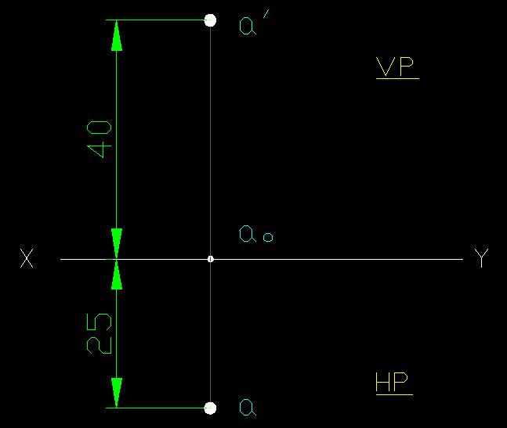
CASE 1: Point A is 40 mm above HP & 25 mm infront of VP. Draw Projections.

Slide 5
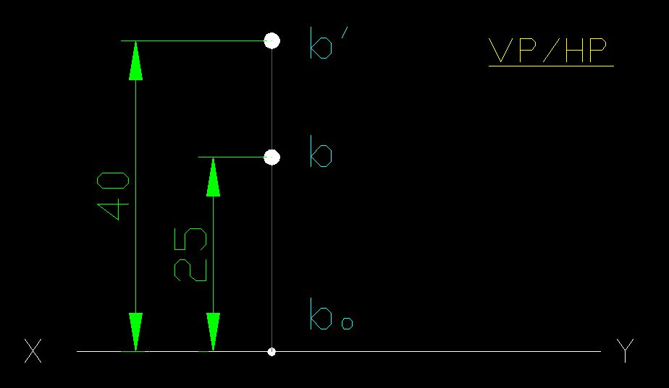
CASE 2: Point B is 40 mm above HP & 25 mm behind VP. Draw Projections.

Slide 6
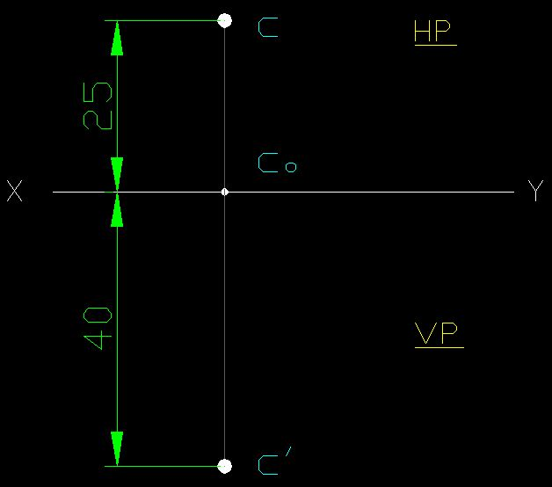
CASE 3: Point C is 40 mm below HP & 25 mm behind VP. Draw Projections.

Slide 7
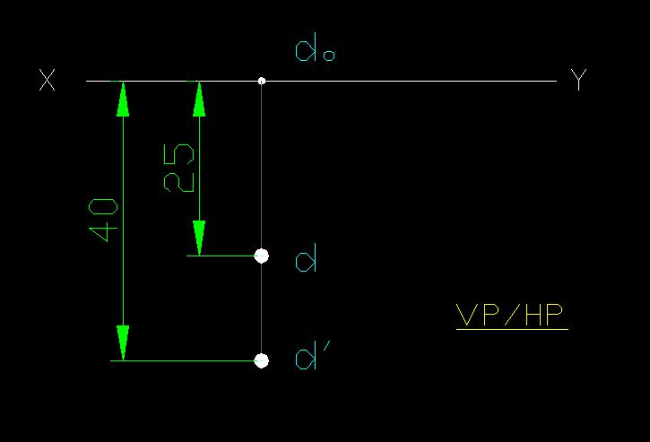
CASE 4: Point D is 40 mm below HP & 25 mm infront of VP. Draw Projections.

Slide 8
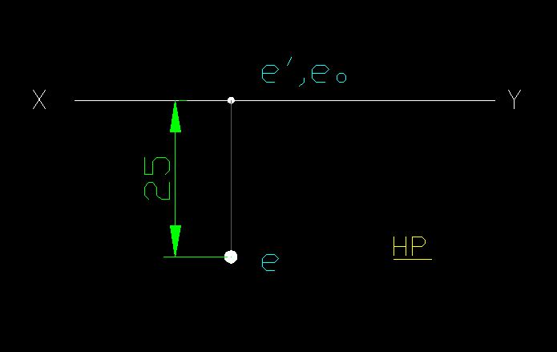
CASE 5: Point E is in HP & 25 mm infront of VP. Draw Projections.

Slide 9
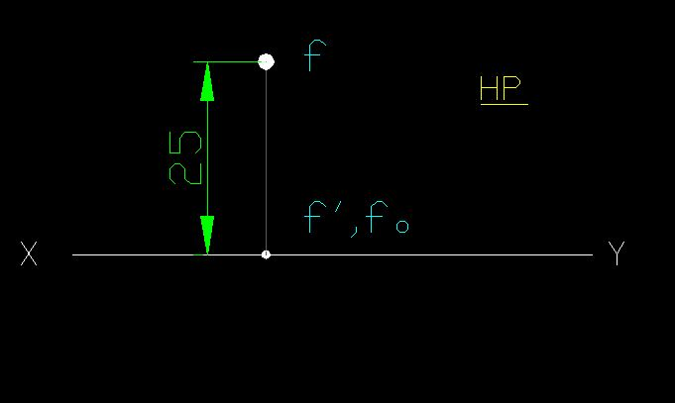
CASE 6: Point F is in HP & 25 mm behind VP. Draw Projections.

Slide 10
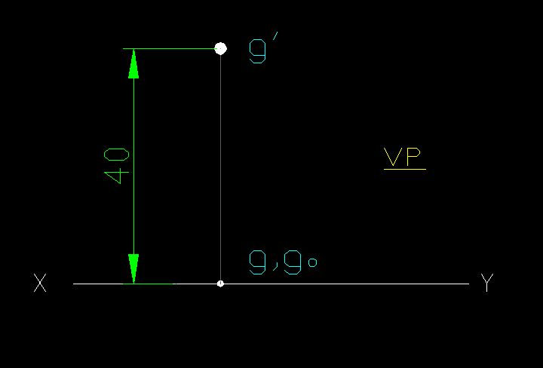
CASE 7: Point G is 40 mm above HP & in VP. Draw Projections.

Slide 11
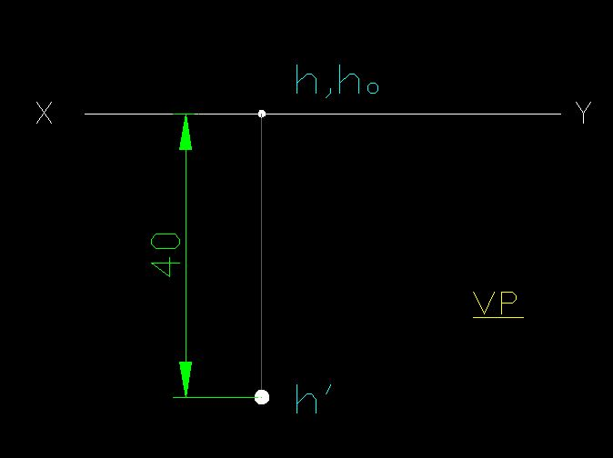
CASE 8: Point H is 40 mm below HP & in VP. Draw Projections.

Slide 12
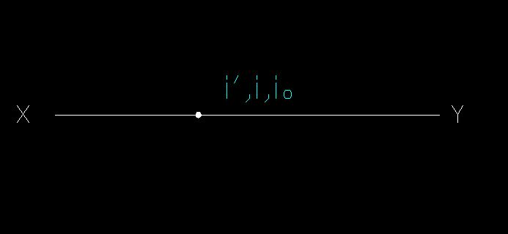
CASE 9: Point I is in HP & in VP. Draw Projections.

Slide 13
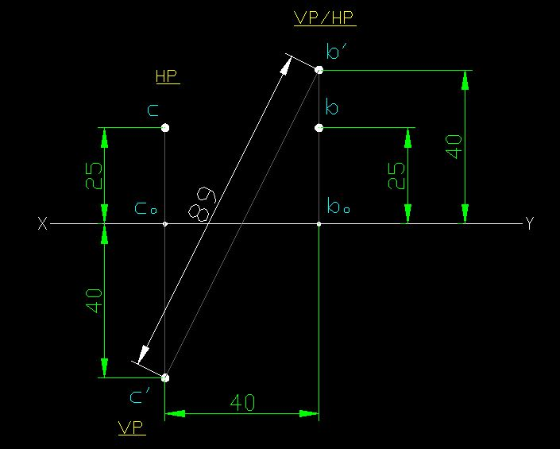
Q: A point C is 40 mm below HP & 25 mm behind VP. Another point B is 40 mm above HP & 25 mm behind VP. The distance between their end projectors is 40 mm. Draw Projections. And find the distance between front views of points c & d.

